Slide 1
Motion in Space

Slide 2
Important Questions
What is Earth’s Place in the Universe?
How do we know what we know?
  Epistemology

Slide 3

Hebrew Conception

Slide 4
Aristarchus (ca. 300 BC)
Developed a heliocentric (sun-centered) model of the universe.
Predicted a parallax shift (between near and far stars) that went unobserved until 1838.

Slide 5
PreCursors
Alexandria
  Greek
  Roman
  Christian
  Arabic Muslim
    Arabic Numerals
  Turkish Muslim
  Crusaders
Albertus Magnus & Thomas Aquinas

Slide 6
Before the Renaissance
Knowledge developed by thinking about how the world works.
Example:
  Which falls faster, a heavy object or a lighter object?
  Aristotle (384-322BC): Obviously the heavier one falls faster! It only makes sense…
But no one thought to test this to see if it were actually true.

Slide 7
The Ancients
1. The Earth is the center of a created world (including Sun, moon, stars, planets and comets).
2. The Earth doesn’t move.
3. The heavenly bodies, except for the five planets (planetos = “wanderers”), travel around Earth in perfect, circular orbits, held in place by crystal spheres.
4. The Stars and planets are made of aether.

Slide 8
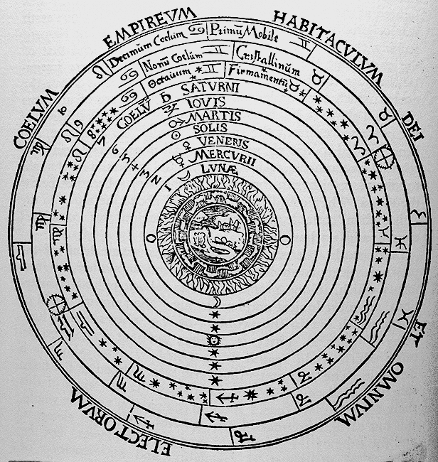

Slide 9
Claudius Ptolemy (90 - 168)
Elaborate mathematical theory
  Describes planets moving in epicycles (small circles) while traveling in a circle around the Earth.
  Useful for predicting eclipses
  Not completely consistent with observed motions.

Slide 10
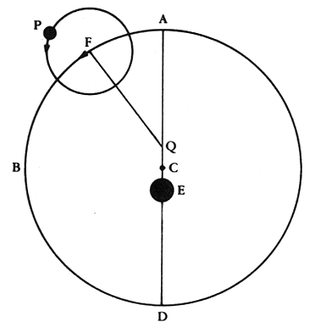
(E) Earth
  eccentric (not centered)
  fixed
(C) Deferent
  orbits the earth (E)
(Q) Equant
  orbits the deferent (C)
(F) Epicycle point
  orbits the equant (Q)
(P) Planet
  Orbits the (F) Epicycle point

Slide 11
The Players
Alexandria
Arabic Numerals
Thomas Aquinas
Nicolaus Copernicus (1473-1543)
Francis Bacon (1561-1626)
Tycho Brahe (1546-1601)
Johannes Kepler (1571-1630)
Galileo Galilei (1564-1642)
Rene Descartes (1596-1650)
Isaac Newton (1642-1727)

Slide 12
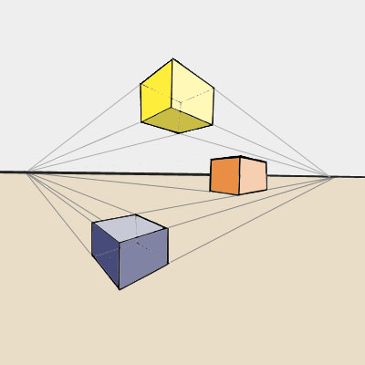
Nicolaus Copernicus (1473-1543)
Canon (minor order) of the Frauenberg Cathedral
Studies perspective and uses math to make 2D art appear 3D
Asserted that an elegant universe must have an elegant explanation

Slide 13
What if…one stood on the Sun?
The Earth makes a full turn on axis every day.
The Earth orbits the Sun once per year.
The Universe is larger than previously thought.
The Earth is a planet among others.
One could figure out the order of the planets (and Copernicus does).
Copernicus writes his ideas quietly, they are published shortly before he dies.

Slide 14
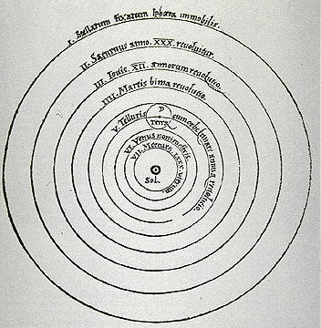

Slide 15
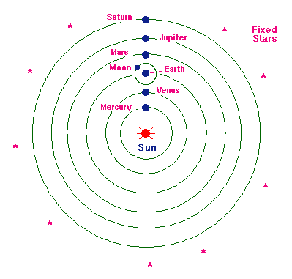

Slide 16
Pope John Paul II
“Although Copernicus himself saw his discovery as giving rise to even greater amazement at the Creator of the world and the power of human reason, many people took it as a means of setting reason against faith.”

Slide 17
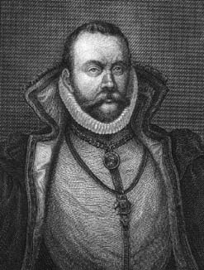
Tycho Brahe (1546-1601)
At 18, he builds his own astronomical instruments
Made exact measurements that were not explained by Copernicus’ model

Slide 18
Francis Bacon (1561-1626)
Franciscan Monk
Philosopher
Asserted that science should be based on observation and experimentation, not “common sense” and theology
Predicted the invention of the telescope

Slide 19
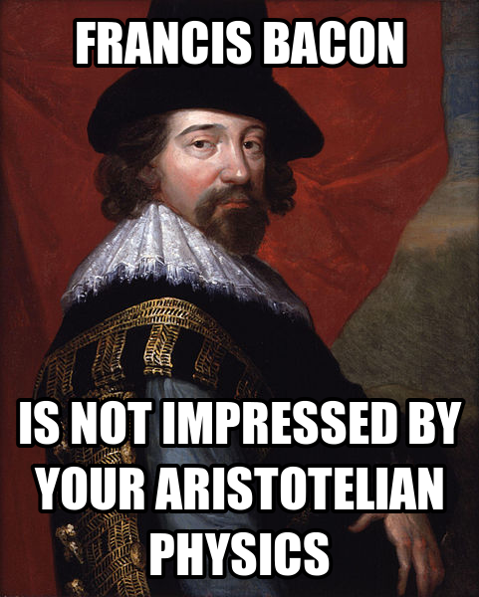

Slide 20
Tycho Brahe (revisited)
In 1572, he discovers a new star.
  According to Aristotle, this shouldn’t happen. The heavens are fixed!
He observes a comet that, by his measurements, has passed through the crystal spheres that Aristotle asserted keeps the stars in their place.

Slide 21
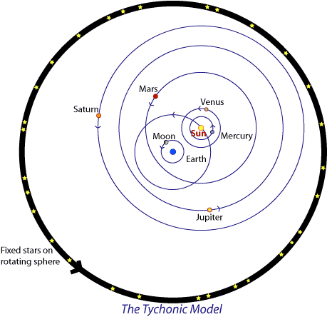

Slide 22
Johannes Kepler (1571-1630)
Worked for years to reconcile Copernicus and Brahe.
Had poor eyesight so he partnered with Brahe who helped him read his charts
If Aristotle’s idea of crystal spheres was wrong, Kepler hypothesized a force from the sun keeping everything in place.
Writes Laws of Planetary Motion involving elliptical orbits

Slide 23
Kepler’s Laws
Planets travel in elliptical orbits with the Sun as one of the foci.
An imaginary line between the Sun and the planet sweeps out equal areas in equal amounts of time. Thus V_{t} is not constant.
T² α r³, where
  T = the period of revolution
  r = average distance between the planet and the Sun
Closely match observations.

Slide 24
Kepler and Religion
“I wanted to become a theologian, and for a long time I was restless. Now, however, observe how through my efforts God is being celebrated in astronomy.”

Slide 25
Kepler and Galileo
Writes and begs Galileo for a telescope
Uses it to confirm Galileo’s discoveries
“I thank you because you were the first one, and practically the only one…to have complete faith in my assertions.” - Galileo to Kepler

Slide 26
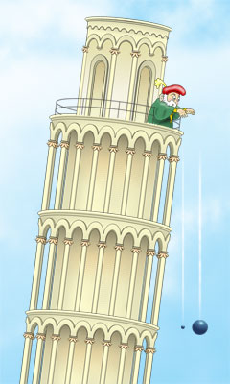
Galileo Galilei (1564-1642)
Rule of Free Fall:
Acceleration due to gravity is constant.
https://www.youtube.com/watch?v=E43-CfukEgs

Slide 27
Galileo’s Principle of Relativity
All steady motion is relative and cannot be detected without reference to an outside point.
  You can’t know you’re moving unless you look out the window.
Ingenious because it connects two otherwise unrelated things: A vehicle’s motion and the Earth’s motion.
  When we look out the earth’s “window” at the heavens, we see our movement in the apparent movement of the heavenly bodies.

Slide 28
Galileo
“…anyone
who considers it more reasonable for the whole universe to move in order to let the earth remain fixed
would be more irrational than
one who climbs to the top of a cupola to get a view of the city…
and then demands that the whole countryside revolve around him so that he would not have to take the trouble to turn his head.”

Slide 29
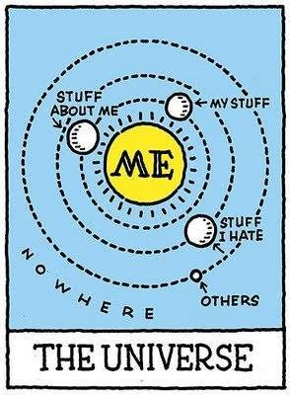

Slide 30
Galileo Observes the Heavens
Galileo hears about a telescope…and so he builds one in 1609.
He observes Jupiter’s moons and spots on the Sun.
publishes The Starry Messenger in 1610
  “I want [them] to see that just as Nature has given to them…eyes with which to see her works, so she has also given them brains capable of penetrating and understanding them all.”

Slide 31
Trouble in Paradise
Galileo insists that mathematical models (especially Copernicus’ model) of the Universe not only yield the right answers, they also portray an accurate picture of reality.
The Aristotelians (the dominant academic powers) don’t like the fact that Galileo’s ideas turns their universities on their heads.
Galileo writes a letter to Castelli ( a former pupil) defending Copernicanism in 1613

Slide 32
The World Scene
1492: Discovery of America
Luther’s “95 Theses”
1545 Council of Trent

Slide 33
Galileo before the Holy Office 1615
Headed by St. Robert Cardinal Bellarmine
For the first time in 1500 years, a Church commission is called to look into the teachings of a scientist
Galileo responds to a series of letters about him and his ideas. He has no conclusive proof for his position. (Proof was offered 10-20 years after his death.)
Scripture apparently contradicted it.

Slide 34
Galileo responds
“The Bible shows the way to go to Heaven, not the way the heavens go,” quoting a Catholic cardinal.
One does not read in the Gospels, “’…the Paraclete…will teach you about the course of the Sun and the Moon.’ For He willed to make them Christians, not mathematicians,” quoting Augustine
Galileo instructs the Office in correct methods of Biblical interpretation.

Slide 35
The Result 1616
After a report from his scientific advisors, Pope Paul V orders Cardinal Bellarmine to warn Galileo to abandon his Copernican views.

Slide 36
Bellarmine
Meets Galileo at his house.
Advises Galileo that science should be based on observation, instructing him on better scientific practices.
reports that Galileo has acquiesced.
At Galileo’s request, certifies that Galileo has not been tried nor condemned, but only warned not to publicly hold or defend the motion of the Earth.

Slide 37
Bad Judgement 1630
Writes Dialogue Concerning the Two Other World Systems
Portrays Aristotelian ideas and in particular, Pope Urban VIII’s (a former friend and supporter) ideas in the person of “Simplicio.”
Resummoned to the Holy Office and accused of vehement suspicion of heresy in 1633
Galileo abjures and submits to house arrest for the remainder of his life.

Slide 38
The Rest of the Story
Three of the ten cardinals refuse to sign the verdict.
Galileo retains a servant and has “every convenience” while under arrest.
Continued scientific research unrelated to Copernicanism.
In 1728, the discovery of the “aberration of light” offers direct experimental evidence of Copernicanism

Slide 39
The Rest of the Story (Cont.)
In 1757, Copernicus’ book is removed from the index of banned books.
In 1822, Galileo’s book is removed from the index
No one else has ever been condemned for a scientific position by an office of the Church.

Slide 40
Pope John Paul II
1984: set up a commission which determined that church officials had erred in condemning Galileo
1992: referred to Galileo as the inspired founder of experimental science and a better theologian than those who condemned him
1994: had the Vatican Post Office issue a stamp in Galileo’s honor

Slide 41
Nota Bene
The condemnation of Galileo was a disciplinary act, not a statement of dogma
The Holy Office did not have authority to define Catholic Teaching.

Slide 42
Albert Einstein
“Pure logical thinking cannot yield us any knowledge of the empirical [experimental] world;
all knowledge of reality starts from experience and ends in it….
Because Galileo saw this, and particularly because he drummed it into the scientific world,
he is the father of modern physics—indeed, of modern science altogether.”

Slide 43
John Gribbin
“Galileo’s key contribution to the birth of science lay
precisely in emphasizing the need for accurate, repeated experiments to test hypotheses, and
not to rely on the old ‘philosophical’ approach of trying to understand the workings of the world by pure logic and reason
the approach that had led people to believe that a heavier stone would fall faster than a lighter stone,
without anyone bothering to test the hypothesis by actually dropping pairs of stones to see what happened.”

Slide 44
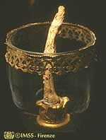
Galileo’s Middle Finger
Preserved in Florence
Points towards Rome

Slide 45
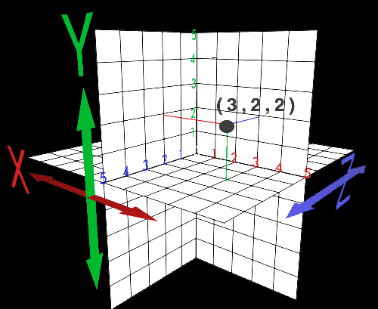
Rene Descartes (1596-1650)

Slide 46
Rene Descartes (1596-1650)
Develops “Cartesian coordinates”
Brings three dimensions to algebra
Allows us to plot variables and compare them
Establishes algebraic notation and the use of exponents and square roots

Slide 47
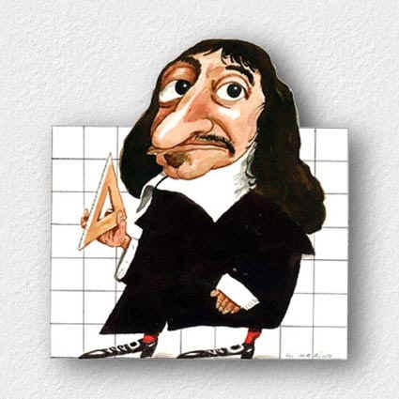
Descartes and Galieo
Knows Galileo is right, but has no desire to stand up to the Church
In danger of arrest, goes to teach the Queen of Sweden, and dies there.

Slide 48
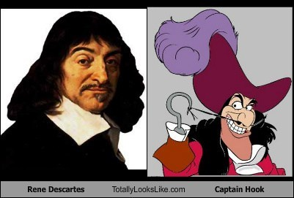

Slide 49
Isaac Newton (1642-1727)
Born to an illiterate father and educated mother
Sent to live with his grandparents then to school
Lives with an apothecary
Not a good student
At 16, called home to work the farm
Mom realizes the mistake and sends him to Cambridge.

Slide 50
Isaac Newton (cont.)
Cambridge students study Aristotle.
Newton also reads up on Copernicus, Galileo, Kepler and Descartes
At 20, buys an astrology book
Doesn’t understand it, so he buys a trig book
Needs to know geometry…
Wonders: why do things fall?

Slide 51
What if?
What if there were a tree in the sky with an apple as big as the Moon?
If this moon-apple fell, would it experience the same force as the apple?

Slide 52
6.5 Law of Universal Gravitation
Every object in the universe pulls on every other object in the universe. The size of the pull is based on the size of the objects and their distance from one another.
F_{g} = Gm₁m₂
r²
G = 6.673 x 10⁻¹¹ Nm²/kg²
Hesitates to publish this idea for fear of fame and criticism

Slide 53
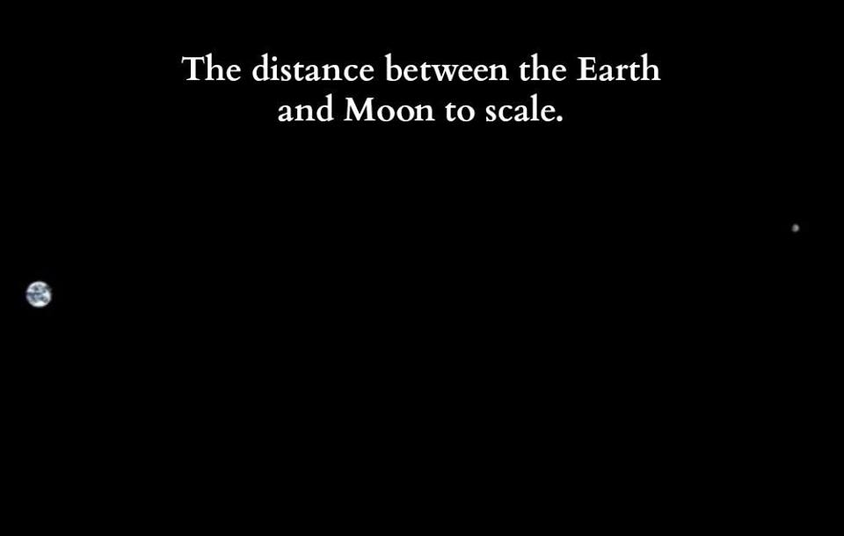

Slide 54
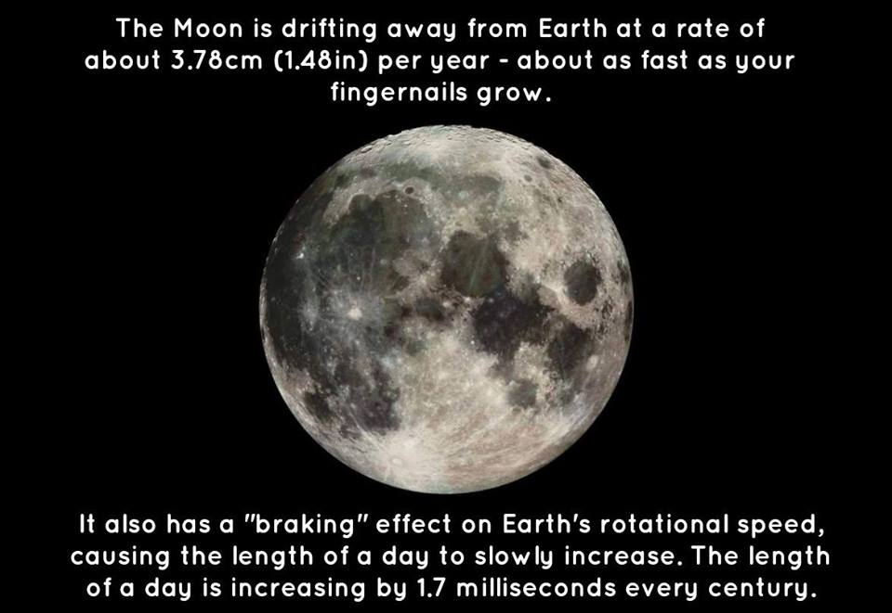

Slide 55
Chart of Constants
p. A-7

Slide 56
6.5 Homework
p. 186 #32, 33, 35, 39, 41

Slide 57
Newton meets Kepler
Let Fc = Fg
m₁v_{t}² = Gm₁m₂
r r²
v_{t}² = Gm₂
r
(2πr/T)²= Gm₂
r
r³ = T²Gm₂
4π²

Slide 58
So…
T² = 4π² r³
Gm₂
And
v_{t}² = Gm₂
r

Slide 59
6.5 Homework
p. 186 #43, 45

Slide 60
Annus Mirabilis
1666- Newton is 23
Develops ideas on gravitation
Lays the foundation for calculus
Comes up with a theory of color
Begins work on laws of motion

Slide 61
Discoveries and Contributions
White light is the sum of all colors
Builds a better telescope
Studies religion and alchemy
Demonstrates that an outside force is necessary for an object to move
Motion isn’t an intrinsic property of matter

